Slide 1
Object Oriented Programming and Design
Presented by
Dr Ramya Devi M
mramyadevi@wilp.bits-pilani.ac.in
CS - 09 : 19th Sep 2025

Slide 2

IMP Note to Self

Slide 3
Object-Oriented Programming
Inheritance and Polymorphism in Java
BITS Pilani

Slide 4
Learning Objectives
What is Inheritance?
Various types of inheritance
Super and Sub classes
Super keyword
Method overriding
What is an Abstract class?
Abstraction with abstract class

Slide 5
Topics
Inheritance in Java

Slide 6
Inheritance Basics
Inheritance is the process by which one class acquires the properties(data members) and functionalities(methods) of another class.
Reusability is achieved by Inheritance
Java classes can be Reused by Extending a class. Extending an existing class is nothing but reusing properties of the existing classes. The class whose properties are extended is known as super or base or parent class.
The class which extends the properties of super class is known as
sub or derived or child class
A class can either extends another class or can implement an interface

Slide 7
Java’s Support For Inheritance
By Extending a Class
Syntax
class
{
……..
}
Example
class A
{
class-name
extends
super-class-name
………
}// End of class A
A
<<super-class>>
class B extends A
{
……..
}// End of class B
B
<<sub-class>>

Slide 8
Java’s Support For Inheritance
By Implementing an Interface
Syntax
class
{
……..
}
Example
class-name implements
interface-name
interface A
{
………
}// End of interface A
A
<<interface>>
class B implements A
{
……..
}// End of class B
B
<<sub-class>>

Slide 9

Forms of Inheritance
Single Inheritance
Hierarchical Inheritance
A
A
X
X
A |  |  | B |  |  | C
A |  |  | B |  |  | C
B
B
Multiple Class Inheritance
Multiple Interface Implementation
NOT SUPPORTED BY JAVA
SUPPORTED BY JAVA
Multi-Level Inheritance Multiple Inheritance
A
A
A
B
A
B
B
B
C
C
C
C

Slide 10
INHERITANCE - Example
General format:
class ChildClass extends ParentClass
{
Members of the child class
}
Example
class Teacher
{
String collegeName=“BITS Pilani";
String designation = "Teacher";
void activity()
{

Slide 11
INHERITANCE - Example
System.out.prinltn("\n Performing Teaching..");
}
}
class MathsTeacher extends Teacher
{
String subject="Mathematics";
void grade()
{
System.out.println("\n Secondary Teacher..");
}
public static void main(String aa[])
{

Slide 12
INHERITANCE - Example
MathsTeacher mt=new MathsTeacher();
System.out.println("\n College name is "+mt.collegeName);
System.out.println("\n Designation "+mt.designation);
mt.activity();
mt.grade();
}
}
In the above example, we have a base class Teacher consisting of the data members collegeName and designation and performs() as its method.
We have a sub class MathsTeacher consisting of the data member subject and grade( ) as its method

Slide 13
Multiple Inheritance in Java
Java Does Not Support Multiple Inheritance by Extending Multiple Classes
The Following Code is Wrong
class A class B class C
{
{
} // End of class A
} // End of class B
extends A, B
{
}// End of class C
Wrong Java Does not Allow Multiple Class Extensions

Slide 14
Multiple Inheritance in Java ….
Java Supports Multiple Inheritance by Implementing Multiple Interfaces
The Following Code is Correct
interface | A | { | } // End of interface A
interface | B | { | } // End of interface B
class C implements A, B
{
}// End of class C
Java Allows Multiple Interface Implementations

Slide 15
Interface in Java ….
An interface is declared by using the interface keyword. It provides total abstraction; means all the methods in an interface are declared with the empty body, and all the fields are public, static and final by default. A class that implements an interface must implement all the methods declared in the interface.
interface <interface_name>{
// declare constant fields
// declare methods that abstract
// by default.
}
It has static constants and abstract methods.

Slide 16
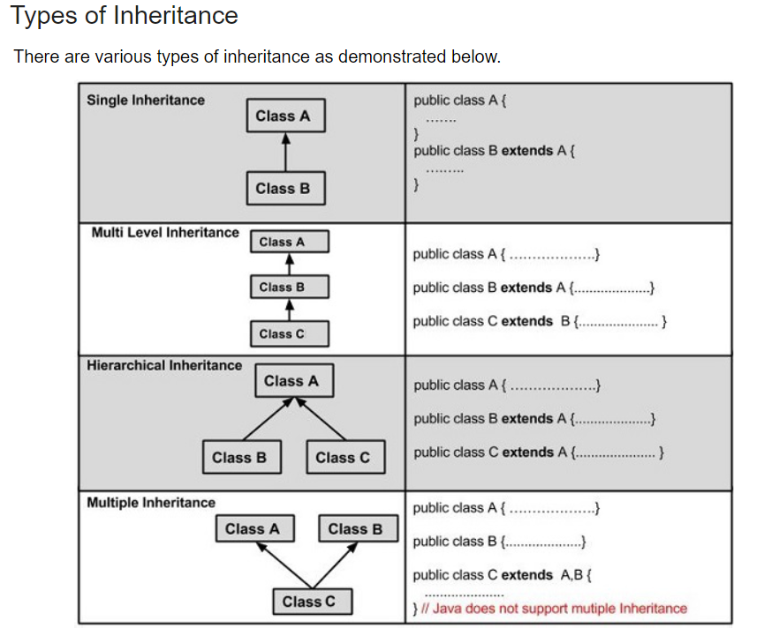

Slide 17
Object-Oriented Programming
Inheritance and Polymorphism in Java
BITS Pilani

Slide 18
Topics
Inheritance Basics - II

Slide 19
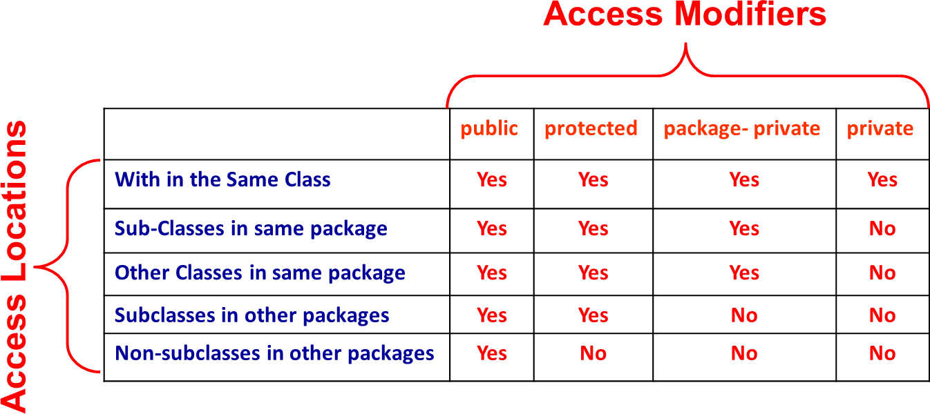
Inheritance Basics
Suppose A is super class of B. Then class B can inherit all the features (Methods and Instance Fields) of class A except the private members.
Super and Sub Classes May Either Belong to Same or Different
Packages

Slide 20
Inheritance Basics ….
Whenever an instance of sub-class type is created, a super-
class constructor is called first.
If a super-class constructor does not have any constructor of its own OR has an un-parametrized constructor then it is automatically called by JRE by using call super()
If a super-class has a parameterized constructor then it is the responsibility of the sub-class constructor to call the super class constructor by call
super(<parameters required by super class>)
Call to super class constructor must be the first statement in
sub class constructor

Slide 21
Constructors in Inheritance
Constructors in Inheritance
When a super class is inherited in the sub class, its constructor can also be inherited.
It means that the base class constructor of the super class is accessible in the sub class also.
There are two methods of inheriting the super class constructor in the sub class. They are
Inheriting non parameterized constructor
Inheriting parameterized constructor
In Java, constructor of base class with no argument gets automatically called in derived class constructor.

Slide 22
INHERITANCE - Example:
class Base
{
Base() {
System.out.println(" It is the Super class Constructor ");
}
}
class Derived extends Base
{
Derived()
{
System.out.println(" It is the Sub Class Constructor ");
}
}

Slide 23
Example
class SuperConstDemo1
{
public static void main(String aa[])
{
Derived d = new Derived ();
}
}
The output of the above coding is
It is the Super class Constructor
It is the Sub Class Constructor
Note:- The super class constructor is automatically executed in the sub class. This constructor is executed before the sub class constructor

Slide 24
Example – Base VS Derived class constructors
But, if we want to call parameterized constructor of base class, then we can call it using the keyword super(). The point to note is that base class constructor calling statement is the first statement in the derived class constructor.
Example:
class Base
{
int data1;
Base(int x)
{
data1=x;
}
}

Slide 25
Example
class Derived extends Base
{
float data2;
Derived(int x,float y)
{
super(x);
data2=y;
}
void display()
{
System.out.prinltn(" Base:"+data1+"Derived:"+data2);
}
}

Slide 26
Example
class SuperConstDemo2
{
public static void main(String aa[])
{
Derived d = new Derived (100,200.50);
d.display();
}
}
The output of the above coding is
Base:100 Derived:200.50
Note:- The super class constructor is executed in the sub class through the keyword super.

Slide 27

Extending Classes : Example 1
When super-class has an Un-parametrized Constructor
// File Name : Sample.java class A
{
Call to a Constructor
A()
{
Method of super-class
System.out.println("This is constructor of class A");
}
} // End of class A class B extends A
{
B()
{
super();
System.out.println("This is constructor of class B");
}
} // End of class B class Test
{
public static void main(String[] args)
{
B
}// End of Method
}// End of Class Test
b1
=
new
B();

Slide 28
Extending Classes : Example 2
When super-class has only a Parametrized Constructor
// File Name : Sample.java class A
{
A(int x, int y)
{
System.out.println("This is constructor of class A");
}
} // End of class A class B extends A
{
B(int a, int b)
A sub-class constructor
must call a parameterized constructor of super-class
{
super(a,b);
System.out.println("This is constructor of class B");
}
} // End of class B class Test
{
public static void main(String[] args)
{
B b1
}// End of Method
=
new
B();
}// End of Class Test
Note : super() statement must be the first statement in a sub-class constructor

Slide 29
Extending Classes : Example 3
‘final’ classes cannot have sub-classes
// File Name : Sample.java final class A
{
A(int x, int y)
{
System.out.println("This is constructor of class A");
}
} // End of class A class B extends A
{
B(int a, int b)
{
super(a,b);
System.out.println("This is constructor of class B");
}
} // End of class B
The Code Will Result in Compile-Time Error.

Slide 30
Role of super Keyword
‘super’ Java keyword primarily used for two purposes
1. To Call constructor method of super-class from a sub-class constructor Syntax:
(i) super() ;
// if super-class has only one un-parameterized constructor
(ii) super(<parameters>); // if super-class has only one parameterized constructor
To call a method of super-class in a sub-class method or to access an instance field of super-class in sub-class especially when their names are similar
Syntax:
super.<super-class-method()> ;
super.<super-class-instance-field>;

Slide 31
Role of super : Example 1
// File Name : XYZ.java class A
{
private int a;
// Constructor Method A( int a)
{
this.a =a;
class B extends A
{
private int b;
// instance field
// instance-field
private double c; // instance field B(int a,int b,double c)
{
super(a); this.b=b; this.c=c;
System.out.println("This is constructor of class A");
} // End of Constructor
// print Method
void print()
{
System.out.println("This is constructor of class B");
}// End of Constructor Method
// show Method void show()
{
print();
System.out.println("a="+a);
} // End of Method
// Display Method void display()
{
System.out.println("b = “ + b); System.out.println("c = “ + c);
}// End of Method
} // End of class B
System.out.println("hello This is Display in A");
} // End of Method
} // End of class A
Call to print() method of super-class Can be Written as super.print()
Call to super-class
Constructor

Slide 32
Role of super : Example 2
// File Name : XYZ.java
class A
{
protected
} // End of class A
class B extends A
{
private
void show()
{
int
int a = 20;
// instance-field
int a = 30;
a = 50;
System.out.println(“ a= “ + a); System.out.prinltn(“ a= “+ this.a); System.out.println(“ a = “+ super.a);
}// End of Method
}// End of class B

Slide 33
Role of super : Example 3
// File Name : XYZ.java class A
{
private int a;
// Constructor Method A( int a)
{
this.a =a;
class B extends A
{
private int b;
// instance field
// instance-field
private double c; // instance field
// Constructor Method B(int a, int b, double c)
{
super(a); this.b=b; this.c=c;
System.out.println("This is constructor of class A");
} // End of Constructor
// print Method
void print()
{
System.out.println("This is constructor of class B");
}// End of Constructor Method
// show Method
void show()
{
super.show();
System.out.println("a="+a);
}
// Display Method
void show()
{
System.out.println(“Hello This is Display in A");
}
} // End of class A
System.out.println("b = “ + b); System.out.println("c = “ + c);
}// End of Method
} // End of class B
Call to show() method of super-class
Call to super class Constructor

Slide 34
Object-Oriented Programming
Inheritance and Polymorphism in Java
BITS Pilani

Slide 35
Topics
Method Overriding in Java
Method Hiding in Java

Slide 36
Method Overriding in Java
Also known as Runtime Polymorphism, Dynamic Method Dispatch or Late Binding
A sub-class overrides an object (instance) method of a super-class if the
following three conditions are satisfied
The method of a sub-class and method of a super class have same name
The method of a sub-class and method of a super class have same
signature
The method of a sub-class and method of a super class have same return type
The scope of a sub-class method should be either same or higher than that of a super-class method
Note : private methods of a super-class are not visible in sub-class. Hence, a sub-class cannot override the private methods of super class.
Call to an overridden method is decided at runtime.
Call to a overridden method is not decided by the type of reference variable. Rather it is decided by the type of the object where reference variable is pointing.

Slide 37

Method Overriding : Example
class A
{
void show(int a, int b)
{
System.out.println("Hello ! This is show() in A");
}// End of show() Method
sub-class B overrides
the show() Method of super-class A
} // End of class A class B extends A
{
void show(int a, int b)
{
System.out.println("Hello This is show() in B");
}// End of show() Method
} // End of class B
// Driver Class
Calls show() from B class
Calls show() from A class
main(String args[])
class Test
{
public
{
static
void
A a1
a1.show(4,5);
=
new
A();
Type of Variable ‘a1’ is A Type of Object is ‘A’
a1 = new B(); a1.show(1,1);
}// End of Method
Type of Variable ‘a1’ is still A But type of Object is ‘B’

Slide 38
Basic Facts About Method Overriding : Fact I
A super class variable can point to any of its sub-class instance
Example : Suppose ‘X’ is the super-class for sub-classes ‘A’, ‘B’ and
‘C’.
A super-class variable of type ‘X’ pointing to a sub-class instance of type ‘A’
<<super-class>>
X
X | x1 | = | new
x1 | = | new | B();
A();
A |  |  | B |  |  | C
<<sub-classes>> A super-class variable of type ‘X’
pointing to a sub-class instance of type ‘B’
A super-class variable of type ‘X’
pointing to a sub-class instance of type ‘C’
x1
=
new
C();

Slide 39
Basic Facts About Method Overriding : Fact II
When a super-class variable points to any of its sub-class instance, then from the sub-class only overridden methods can be invoked by using the same variable
class A
{
void show()
{
}// End of Method
B class overrides show() Method
}// End of class A
A a1
a1.show();
=
new B();
Valid Statement
class B extends A
{
void show()
{
} / End of Method
a1.display();
void display()
{
} / End of Method
Results in Compile-Time Error
}// End of class B

Slide 40
Basic Facts About Method Overriding : Fact III
Overridden Method in sub-class should have either same or higher
scope than the scope of a similar method in the super class.
class A
{
void show()
{
}// End of Method
A’s show() method has package-private scope
}// End of class A
class B extends A
{
public void show()
{
} / End of Method
B’s show() method has public scope
void display()
{
NO ERROR
} / End of Method
}// End of class B

Slide 41
Basic Facts About Method Over iding : Fact I I …
Overridden Method in sub-class should have either same or higher scope than the scope of a similar method in the super class. The scope of overridden method in sub-class should not have lesser scope
class A
{
protected void show()
{
}// End of Method
A’s show() method has protected scope
}// End of class A
class B extends A
{
public void show()
{
} / End of Method
B’s show() method has public scope
void display()
{
} / End of Method
NO ERROR
}// End of class B

Slide 42
Basic Facts About Method Over iding : Fact I I …
Overridden Method in sub-class should have either same or higher
scope than the scope of a similar method in the super class.
class A
{
protected void show()
{
}// End of Method
A’s show() method has protected scope
}// End of class A
class B extends A
{
void show()
{
} / End of Method
B’s show() method has package-private scope
void display()
{
COMPILE-TIME
} / End of Method
}// End of class B
ERROR

Slide 43
Basic Facts About Method Overriding : Fact IV
‘final’ Methods of super-class cannot be overridden by
sub-class.
class A
{
final void show()
{
}// End of Method
A’s show() method is final
}// End of class A
class B extends A
{
void show()
{
} / End of Method
B cannot override final method from super class A
void display()
{
COMPILE-TIME
} / End of Method
}// End of class B
ERROR

Slide 44
Find the Error ?
class A
{
int show(int a, int b)
{
}// End of Method
}// End of class A
class B extends A
{
void show(int a, int b)
{
} / End of Method
void display()
{
} / End of Method
}// End of class B
Compile-Time Error
(Overridden Methods Cannot Have Different Return Types)

Slide 45
Find the Error ?
class A
{
No Error
void show(int a, int b)
{
}// End of Method
}// End of class A
This Code Represents Method Overloading
class B extends A
{
void show()
{
} / End of Method
B b1
b1.show();
=
new
B();
void display()
{
} / End of Method
b1.show(10,8);
}// End of class B
Calls show() from A class
Calls show() from B class

Slide 46
Does the Following Code Snippet Represent Method Overriding?
class A
{
private void show(int a, int b)
{
System.out.prinltn(“A : “ + (a+b));
}// End of Method
}// End of class A class B extends A
{
void show(int a, int b)
{
System.out.prinltn(“A : “ + (a*b));
} / End of Method void display()
{
} / End of Method
}// End of class B
Method is Private
So, Not Visible in class B
NO. IT DOES NOT REPRESENT METHOD OVERRIDING

Slide 47
Method Hiding
A sub-class can hide a static method (class method) of a super-class if the following conditions are satisfied for class methods
Methods should have same name, same signatures and
same return type
Methods should be static and not instance (or object)

Slide 48
Method Hiding: Example 1
class A
{
public static void show(int a, int b)
{
System.out.println(“ Class A Method :” + (a + b));
}// End of Method
class B hides a static method of super-class A
}// End of class A class B extends A
{
public static void show(int a, int b)
{
System.out.println(“ Class B Method :” + (a * b));
} // End of Method
}// End of class B class Test
{
public static void
{
A
main(String[] args)
a1 =
OUTPUT
new
A();
a1.show(5,6);
a1 =
new
B();
class A Method: 11 class A Method: 11
a1.show(5,6);
}// End of Method
}// End of class Test

Slide 49
Method Hiding: Example 2
class A
{
protected static void show(int a, int b)
{
System.out.println(“ Class A Method :” + (a + b));
}// End of Method
class B hides a static method of super-class A
}// End of class A class B extends A
{
public static void show(int a, int b)
{
System.out.println(“ Class B Method :” + (a * b));
} // End of Method
}// End of class B class Test
{
public static void
main(String[] args)
OUTPUT
{
A
a1
=
new
A();
a1.show(5,6);
a1
=
new
B();
class A Method: 11
class A Method: 11
a1.show(5,6);
}// End of Method
}// End of class Test

Slide 50
Method Hiding: Example 3
class A
{
public static void show(int a, int b)
{
System.out.println(“ Class A Method :” + (a + b));
}// End of Method
}// End of class A class B extends A
{
public void show(int a, int b)
{
System.out.println(“ Class B Method :” + (a * b));
} // End of Method
}// End of class B class Test
{
public static void
{
A
main(String[] args)
a1 =
new
A();
a1.show(5,6);
a1 =
a1.show(5,6);
COMPILE-TIME ERROR
new
B();
}// End of Method
}// End of class Test

Slide 51
Method Hiding: Example 3
class A
{
public static void show(int a, int b)
{
System.out.println(“ Class A Method :” + (a + b));
}// End of Method
}// End of class A class B extends A
{
protected static void show(int a, int b)
{
System.out.println(“ Class B Method :” + (a * b));
} // End of Method
}// End of class B class Test
{
public static void
{
A
main(String[] args)
a1 =
new
A();
a1.show(5,6);
a1 =
COMPILE-TIME ERROR
new
B();
a1.show(5,6);
}// End of Method
}// End of class Test

Slide 52
Object-Oriented Programming
Inheritance and Polymorphism in Java
BITS Pilani

Slide 53
Topics
Abstract Methods
Abstract Classes

Slide 54
Abstract Methods and Abstract Classes
Abstract Method → Method with only declaration part and without
implementation [Incomplete Method]
Abstract Classes → If a class has any one abstract method [Incomplete Class]
Example
abstract class Sample
{
public void doSome1()
{
System.out.prinltn(“Hello”);
}
public void doSome2()
{
System.out.prinltn(“Hi”);
}
Non-Abstract Methods
Abstract Class
public abstract void doAny(); // Abstract Method
}// End of class Sample
Abstract-Methods

Slide 55
Abstract Classes
An abstract class is a class which has abstract methods (i.e. a
method with only heading with no body of executable statements)
An object or instance of abstract classes can not be instantiated
An abstract class needs to be extended by sub classes to provide
the implementation for the abstract methods.
Abstract classes may contain static methods also. However, abstract and static keyword combination is wrong
abstract static void print(); // wrong
Abstract classes may extend either another abstract class or concrete (complete or non-abstract) class
Abstract classes may include constructors, nested classes and
interfaces
Abstract classes has either public, protected, private or package accessibility

Slide 56
Abstract Classes : Syntax
Syntax :
<scope>
abstract
class <class-name>
[extends
<super-class-name>]
[implements
interface-1, interface-2, …., interface-n]
{
...........................
<scope>
<scope>
abstract
abstract
<return type>
<return type>
method-name-1(<parameter List>);
method-name-2(<parameter List>);
……………………………….. abstract <return type> method-name-n(<parameter List>);
<scope>
}
Note:
Abstract class can have one or more abstract methods
Abstract classes may extend another class , implements another interface , may have concrete methods

Slide 57
Abstract Classes : Fact I
A class can be declared as abstract even if it does not
have any abstract method
Example:
abstract class A
{
public void doS(int a, int b)
{
System.out.println(a+b);
}// End of Method
}// End of class A

Slide 58
Abstract Classes : Fact II
Only instance
methods (object methods) can be
declared as abstract.
‘static’ and ‘abstract’ forms illegal combination
Example:
abstract class A
{
public static abstract void doS(int a, int b);
}// End of class A

Slide 59
Abstract Classes : Fact III
An abstract class may extend either another abstract
class or a concrete (non-abstract) class
Example
abstract class A
{
}// End of class A
abstract class B extends A
{
}// End of class B
class A
{
}// End of class A
abstract class B extends A
{
}// End of class B

Slide 60
Abstract Classes : Fact IV
An instance or object cannot belong to an abstract class.
However a variable can belong to an abstract class type.
Example
abstract class A
{
}// End of class A
A a1 = new A();
Compile-Time Error: Object Cannot belong to Abstract Class Type
A a1 = new B();
Correct: Abstract Class Type Variable Can Point to Any Concrete Sub-class Instance
a1 = new C();
class B extends A
{
}// End of class B
class C extends A
{
}// End of class C
Correct: Abstract Class Type Variable Can Point to Any Concrete
Sub-class Instance

Slide 61
Abstract Classes : Fact V
When any class say ‘X’ extends an abstract class say ‘Y’ then in order for class ‘X’ to be a complete or concrete class, the class ‘X’ must implement all the abstract methods of class ‘Y’ otherwise class ‘X’ has to be declared as abstract.

Slide 62
abstract class Shape {
String color;
Shape(String color) {
this.color = color;
}
abstract double area();
void display() {
System.out.println("Color: " + color);
}
}
class Rectangle extends Shape {
double width, height;
Rectangle(String color, double width, double height) {
super(color);
this.width = width;
this.height = height;
}
double area() {
return width * height;
}
}

Slide 63
Abstract Method
Rules of Abstract Method
1. Abstract methods don’t have body, they just have method signature as shown above. 2. If a class has an abstract method it should be declared abstract, the vice versa is not true, which means an abstract class doesn’t need to have an abstract method compulsory. 3. If a regular class extends an abstract class, then the class must have to implement all the abstract methods of abstract parent class or it has to be declared abstract as well.

Slide 64
Thank You

